Slide 1
Data-driven systems
Query optimization

Slide 2
Contents
Purpose of query optimization
Microsoft SQL Server
Execution plans
Join and table access options
General recommendation
MongoDB
Indices and execution plans

Slide 3
What is the purpose of query optimization?

Slide 4



What is the purpose of query optimization?

Slide 5

What is the purpose of query optimization?

Slide 6
Response time is affected by
I/O cost
Most prominent in data bases
Does not improve according to Moore’s law
Needs special tricks
CPU usage
Complex queries
Complex computations
Memory usage
Cache effect

Slide 7
Microsoft SQL Server
General concepts
Notes:
... similarly in other relational databases

Slide 8
Basics of the optimization
Evaluates based on statistics
Cost = response time (CPU + I/O time)
Trivial plan
Unambiguous for simple queries
Rule-based
When no trivial plan is available
Complex queries
Three phase optimization

Slide 9
Three phase optimization
No trivial plan
0. Phase
Simple optimizations
Preferred hash join
If cost < X → execute
1. Phase
Complex optimizations
If cost < Y → execute
2. Phase
Parallel execution

Slide 10
Process of executing a query
Analyzer
Compiler
Logical plan
Optimization
Physical execution plan
Read tables
Joining tables
Row executor
Mapping physical plan to I/O operations
Executor
Executes the operations

Slide 11
Microsoft SQL Server
Logical execution plan

Slide 12
Elements of the logical execution plan
Parser tree
Relations (leaf)
Operations (node)
Data flow from bottom to top
Relational algebra operations
Cartesian-join (R×S)
Projection (π_{L}(R))
Selection (σ_{F}(R))
Join (R⋈S)
Filtering duplicates (δ(R))
Grouping (γ_{L}(R))
Sorting (τ_{L}(R))
a + b * c
+
a
*
b
c

Slide 13
Parser tree
select establishedYear
from owner o, company c
where o.id = c.ceoid AND name like '%John'
π
establishedYear
σ
id
=
ceoid AND name like ’
%
John’
×
owner
company

Slide 14
Refactoring the parser tree - 1
Create an optimal logical execution plan
Reduce possible physical execution options
Basic concept
Move selection (where) down in the three
Using joins
Cartesian join only when explicitly specified
One side of a join should be a table

Slide 15
Refactoring the parser tree - 2
Selection
Can be re-ordered: σ_{F1}(σ_{F2}(R)) = σ_{F2}(σ_{F1}(R))
Can be re-written:
σ_{F and G}(R) = σ_{F}(σ_{G}(R))
σ_{F or G}(R) = σ_{F} (R) UNION σ_{G}(R)
Join
R⋈_{F}S = σ_{F}(R×S)
R⋈S = S⋈R
(R⋈S)⋈U = R⋈(S⋈U)
Notes:
In other words, joining is associative and commutative

Slide 16
Refactoring the parser tree - 3
Joining and selection
σ_{F}(R⋈S) = σ_{F}(R)⋈S
If R has all attributes of F
σ_{F}(R⋈S) = R⋈σ_{F}(S)
If S has all attributes of F
σ_{F}(R⋈S) = σ_{F}(R)⋈σ_{F}(S)
If both R and S has attributes of F
Duplicates
δ(γ_{L}(R)) = γ_{L}(R)
δ(R×S) = δ(R) × δ(S) (similarly for joins)

Slide 17
Microsoft SQL Server
Physical execution plan

Slide 18
Physical plan
Elements of the physical plan
Operators for reading the table
Logical plan leaf reading operations
Executing relational algebra operations
Creating plans
Rule-based
Cost-based
Table seek methods
Implementation of joins
Order of joins

Slide 19
Nested loop join
Two embedded for cycles
I/O cost
O(num_block_1 * num_block_2)
Works in all cases
In case of large tables: keep only partitions of the tables in memory

Slide 20
Hash join
First pass
Read the smaller table
Build a hash table in memory
Key is the column used for joining
Second pass
Read the larger table
Search for matching records in the hash table
I/O cost
O(num_block_1 + num_block_2)

Slide 21
Sort Merge Join
Reads both tables into memory
Sorts based on the joined columns
Merge the two sorted lists
While "walking" the two sorted lists
For small tables
Index due to sorting
I/O cost
O(num_block_1 + num_block_2)

Slide 22
Table scan methods - 1
Generally there are two ways
Full scan
For small tables
When most rows are needed
Index scan
When using filtering
If there is an index covering the filter criteria
Sorting

Slide 23
Table scan methods - 2
Table scan
No index
Evaluates the filtering condition
Clustered index scan
Clustered reading
Data blocks ordered by index
Clustered index created along primary key
Preferred over table scan

Slide 24
Table scan methods - 3
Nonclustered index scan
Similar to clustered index scan
Mostly for evaluating =
Clustered/Nonclustered index seek
Similar to index scan
Walks the index from a starting point
>, between, < operators

Slide 25
MS SQL Server indexes
B* tree
Simple
Compound indexes
Hierarchical
Clustered
Data blocks orderes by index
One for each table
Automatically created for the primary key

Slide 26
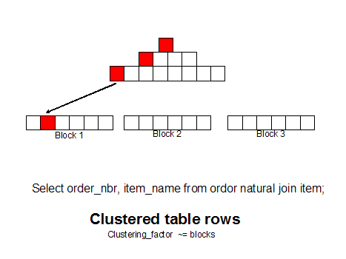
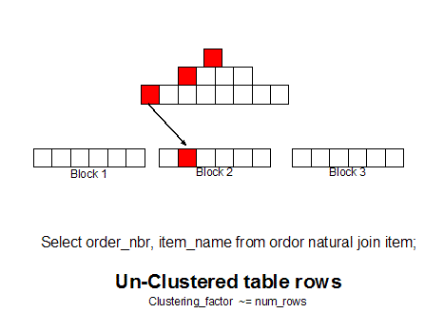
MS SQL Server indexes
Clustered / non-clustered
Source: http://www.dba-oracle.com/t_table_row_resequencing.htm

Slide 27
Indexes - 1
Cover index (included column)
Adding further data into the B* tree leaf nodes
The row data does not need to be accessed
Using clustered and non clustered indices togather
Nonclustered index leaf
Does not contain a physical address
Points to the clustered index
Double index read

Slide 28
Indexes - 2
Indexed views
The view result is stored
Index can be defined, works as for tables

Slide 29
Plan cache
Plan cache
Plan cache
For similar queries
Statistics have not changed

Slide 30
Stored procedures
create proc test
@pcs int as
select *
from Product
where InStock<@pcs
create proc test
@pcs int as
select *
from Product
where InStock<@pcs
option (optimize for (@pcs=2))
exec test 20
exec test 2 with recompile

Slide 31
Microsoft SQL Server
General recommendation

Slide 32
Best practices - 1
Keep statistics up to date
Deprecated statistics →suboptimal execution plan
(This is the default unless turned off)
Structure of the query
SQL is declarative
Keep procedural execution in mind
Same result can be obtained multiple ways
Make it simple
Avoid select *
Good structure is advantageous
Use hints as a last resort

Slide 33
Best practices - 2
Prefer join over
In / Not in
Exists / Not exists
Prefer In over Exists
Views
Avoid if possible
Do not join them
Avoid Or clauses →Union all
Union all if possible

Slide 34
Best practices - 3
select *
from Invoice i
where not exists
(
select 1
from InvoiceItem ii
where i.Id=ii.InvoiceID
)
select i.*
from Invoice i
where i.id not in
(
select InvoiceID
from InvoiceItem
)
select i.*
from Invoice i left outer join InvoiceItem ii
on i.Id=ii.InvoiceID
where ii.id is null
Does not matter in simple cases

Slide 35
Best practices - 4
Using indexes
Usually one can be used for one table in a query →Join may use it up
Compound indexes
Hierarchy matters
If the key is used in an expression, the optimizer cannot use it
E.g., key+0
(← Optimizer may handle this though)

Slide 36
Best practices - 5
Using functions
No problem in a select
Does not affect the execution plan
Avoid in a where clause
Has to be evaluated for each record
Hard to move in the query tree
No statistics are available for its output → hard to optimize

Slide 37
Further reading material
Grant Fritchey: SQL Server Execution Plans, Simple Talk Publishing, 2012
pdf: http://www.red-gate.com/community/books/sql-server-execution-plans-ed-2

Slide 38
MongoDB

Slide 39
Indices in MongoDB
Index “only” for lookup
(As there is no join operation)
Types of indices
Simple and compound
Unique index
Can be used to ensure a primary key-like attribute
Indexes content of arrays too
Indexes nested objects too
TTL, Geospatial, full text
Index must be defined
Except: _id unique

Slide 40
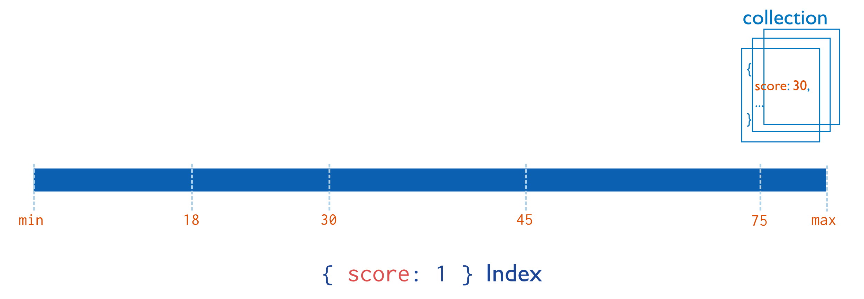
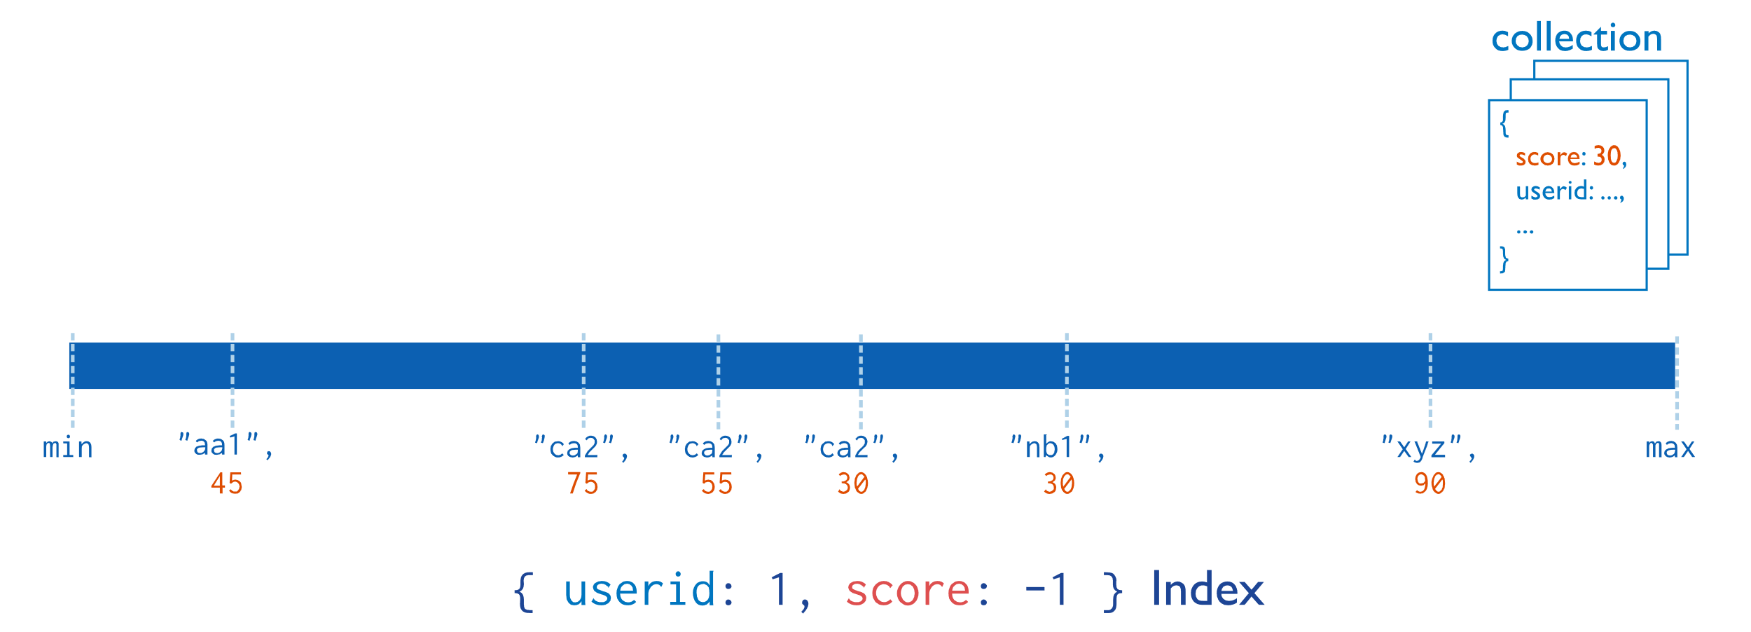
Types of indices
Simple
Compound indexes
Images source: https://docs.mongodb.com/manual/indexes/

Slide 41
Basics of the optimization
Does not use statistics
Choice between multiple possible plans
Starts execution all, whichever yields the first 101 results, is the best
How can there be multiple plans?
There are multiple indices covering the query

Slide 42
Optimization steps
Move filtering ahead of other steps
Before projection, and if needed, split the filtering into two
Before sorting
Move skip and limit ahead
Projection
Merge
Limit + limit, skip + skip

Slide 43
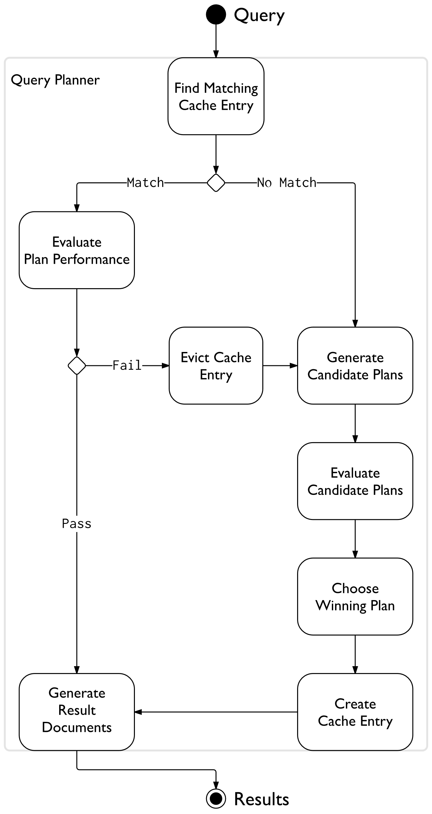
Plan cache
Image source: https://docs.mongodb.com/manual/core/query-plans/

Slide 44
Plan cache
Plan cache
Structurally similar plans
Pass/fail evaluation
Query shape
Filters, sorting, etc. used
No values
E.g. for filtering only the filtered field name is present

Slide 45
Explain
query.explain()
"winningPlan" : {
"stage" : <STAGE1>,
...
"inputStage" : {
"stage" : <STAGE2>,
...
"inputStage" : {
"stage" : <STAGE3>,
...
}
}
},
"rejectedPlans" : [
<candidate plan 1>,
...
]
Stage-ek
COLLSCAN
IXSCAN
FETCH
…

